Slide 1

Do Less. Make it mean more.
All materials and methodologies are copy written and protected Intellectual Property of Kate Burda & Company and for the express purpose.
Systems, Methodology, and constructs are not for external distribution and are protected.

Slide 2

AGENDA SLIDE
WRITE YOUR SUBTITLE HERE
Page
2-5
Page
6-9
Page
9-10
Page
11-12
Page
13-14
Page
15
The Problem
The Solution
The Market
The Team
The Traction
The Ask

Slide 3


What’s the Problem?
Financial Programs
CRM

Slide 4




What we know
90%
61%
90%
5%
$1.3
90%
of organizations fail to execute
strategies successfully
60%
of organizations don’t link strategy to financial outcomes
90%
of tactics weren’t aligned with overall strategy
Only 5%
marketing initiatives were focused on most valuable customers
$1.3 million
that was unaccounted for with traditional revenue strategies

Slide 5

Problem 1: Teams have difficulty building strategy in a volatile, complex, and ambiguous marketplace
90% of action plans or tactics didn’t connect to a strategy or revenue vision
-HBR
60% strategies don’t link to financial outcomes or goals
- Archpoint
Only 5% of marketing initiatives were focused on the most valuable customer
-KB & Co
EXECUTE-
Post Funding
Do Less. Make it Mean More.

Slide 6


Problem 2: The connection between strategy and execution
is more critical than ever
…yet, what we have time, resources, and tools to achieve.
A revenue roadmap built from data-driven decisions ensuring impact is what I want…

Slide 7

Problem 3: There is little margin left in operational efficiencies. Growth will come from the top line.
Covid has forced companies to be come extremely efficient operationally.
Growth will come from top-line revenue performance.
Yet, there is not a system that helps create the financial roadmap that drives that top-line performance and execution.
#truth
EXECUTE-
Post Funding
$1.3- $2 million in overlooked or unrealized revenue

Slide 8
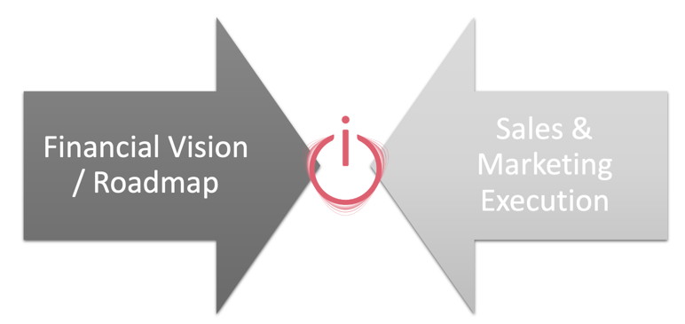
The solution wasn’t out there. So, we built it.
A turbo-tax experience that:
Enables, Elevates, and Ensures Execution
Creates the Revenue Roadmap

Slide 9
Total Addressable Market
17,000+ Users
Oracle’s NetSuite
15,000 Companies
SalesForce
7,000+
Hubspot
If they are their customers, they are a customer for Ignite.
Prep & Prime
Pitch &
Promote

Slide 10
Specific Addressable Market
Travel
Real Estate
Professional Services
Pharma and Life Sciences
Small Business and Start Ups
EXECUTE-
Post Funding
Marketplace
- Management Companies= 75+ ww, 10,000 rooms +
- Independent= 99,000 hotels
-Top Real Estate Firms do not have a BI system into top line revenue strategy.
(CBRE, JLL, Cushman & Wakefield)
Law Firms in Texas: 34,929 Generating: $24B
Management Companies= 75+ ww, 10,000 rooms +
Independent= 99,000 hotels ww
771 hospitality technology company
Core identified partners
7,000 hotels
8,000 hotels
1- Targeted reseller manages $337B transactions in 2017
2- Another core focus reseller managed $252B
Unidentified at this point
2 smaller tech firm serving pharma identified and conversations
Unidentified at this point
Resellers
Industry is of the top 5 vertical of CRM systems within Salesforce
Current systems
Arms race within competitors to be more effective in creating value to customer
4% growth in the last 10 years
“We don’t have any idea who is our most profitable segment”
Pharm and Life Sciences Organizations spend over $7M in CRM systems.
Most start ups fail because they don’t have the right strategies in place.
Of note:

Slide 11






Meet the Team
The Deal Maker
The Architect
The Sage
The Fire Starter and Vision
Andrea Lofton
Eddie Westerfield
30+ years in leading sales and marketing teams in multi-national firms.
Product development and operational management. Eddie has built programs and companies. We have the human equivalent to swiss army knife dedicated to Ignite.
The Checks & Balances
The Law
Diane Estner
Entrepreneur, Strategic Advisor, Lifelong Learner. PHD from School of Hard Knocks!
Kate Burda
Dina Tarro
30+ leading multi- national teams in transformation, strategy and execution.
Morris Buchanan
Protector of the vision and the work. Has developed and sold companies a few times over.
Morris takes brilliance of the work to the reality of ‘having it pencil’. 30+ years finance and strategy.

Slide 12

Traction
Since receiving it from developers May 2021 we currently have as customers:
A hotel management firm
A wine distributor
A destination management organization
Multi-national asset management firm
Total revenue: $25,000
Prep & Prime

Slide 13
The Revenue Projection

Slide 14

The Ask
$500k
How it will be used
MVP to 1.0
Scale the Product
AI / ML
Attract and Retain Talent
Go-To-Market Strategy

Slide 15


